Slide 1
Access to Essential Services
Enhancing Rural Transportation Planning through Accessibility Metrics
Shirley Shiqin Liu, PhD
Accessibility Observatory, Center for Transportation Studies
2025 Modeling Mobility Conference
17 September 2025

Slide 2




Accessibility Observatory
Research unit in CTS
Grant-funded projects
FHWA pooled fund
State DOTs
MPOs
Regional & Local
USDOT collaborations
Eric Lind
Shirley Shiqin Liu
Andrew Owen
Matthew Hockert
Notes:
- Small and mighty team of four members
National Accessibly Evaluation – a FHWA pooled fund project. we also partner with other state and local agencies to introduce and evaluate access measures for performance measures and project prioritization.

Slide 3
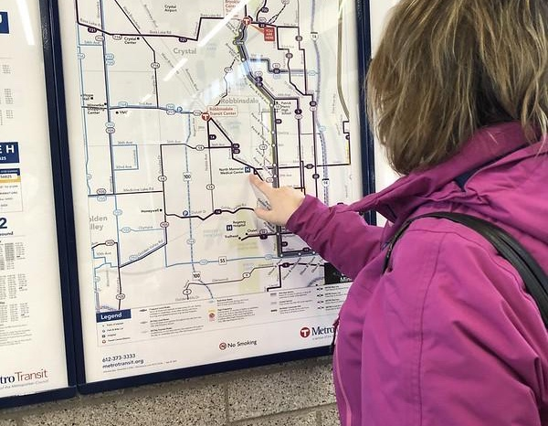
What is Accessibility?
The ease with which a traveler could reach valued destinations
Notes:
When we talk about accessibility in transportation, we mean the ease with which a traveler can reach valued destinations

Slide 4
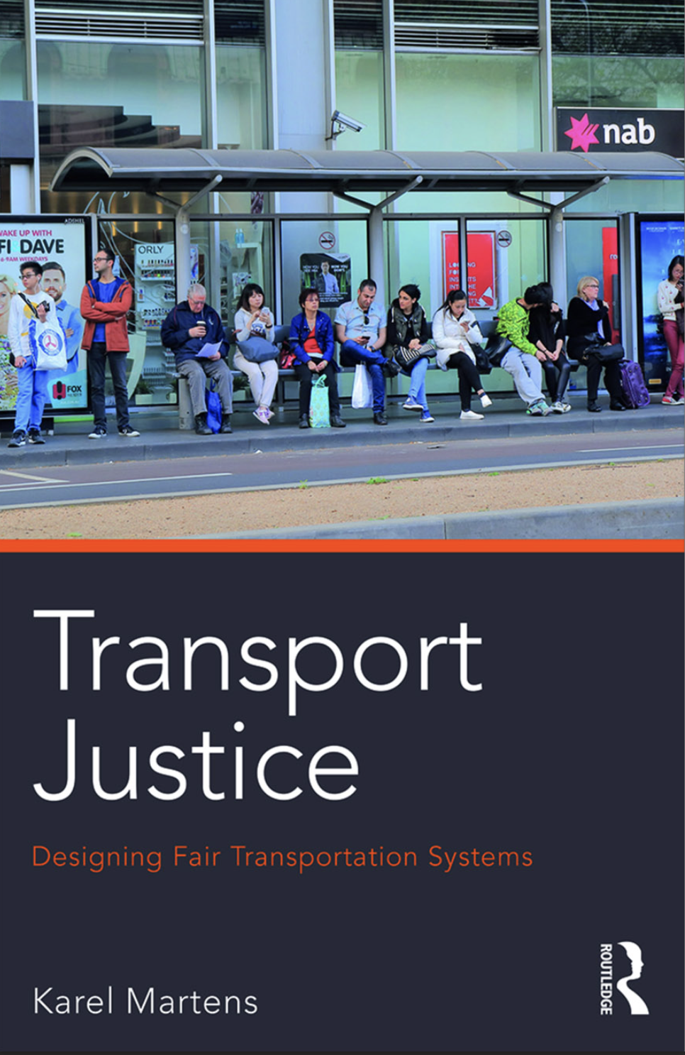
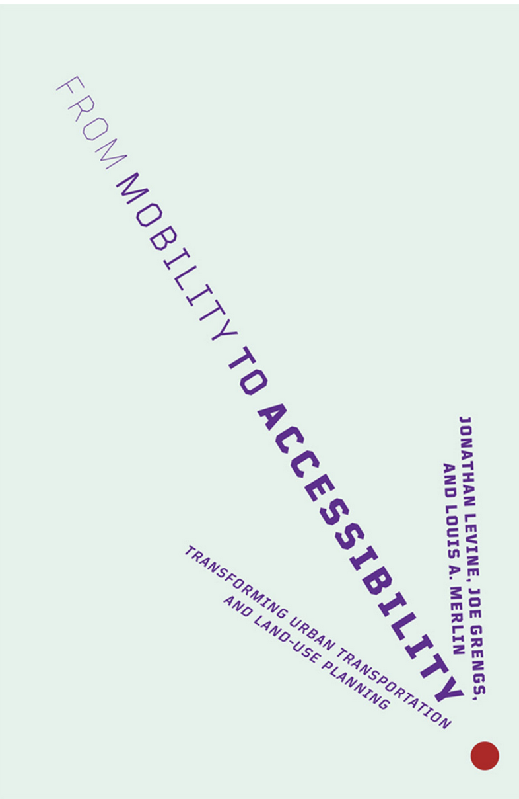
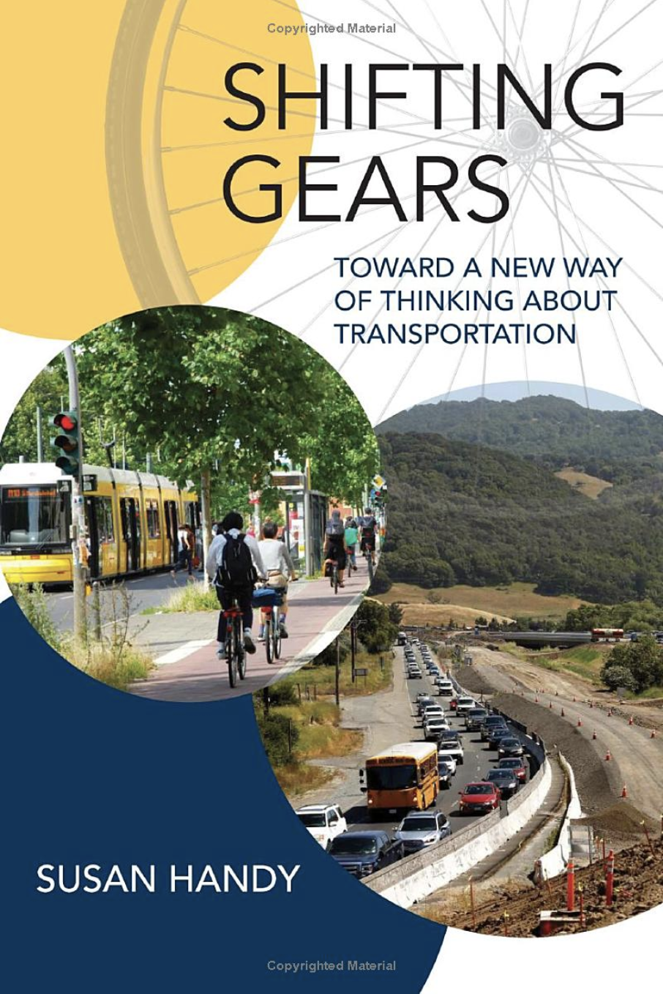
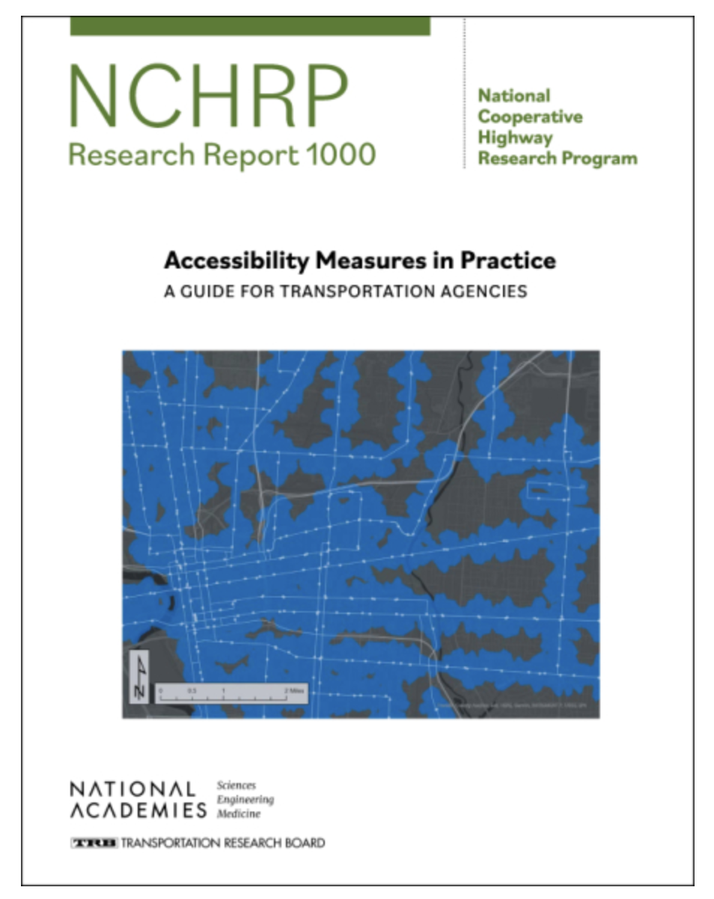
Levine, Grengs, Merlin 2019
Martens 2017
NCHRP 1000
Karner et al. 2022
Handy 2023
Notes:
This concept is grounded in decades of research.
Accessibility moves beyond just mobility or travel time—it’s about connecting people to opportunities.
It gauges the value of both the transportation and land use system to people.
Levine: "Accessibility" brings proximity into the equation. So mobility-based planning gauges the quality of transportation strictly on how easily one can move to a destination. But the problem is that’s a poor metric for indicating how well one can reach one’s destinations because you can have high accessibility even if you can’t move very fast, if your proximity is high, if your destinations are close or alternatively your destinations can be far away and you can move fast, but you still have low accessibility. So it’s really only accessibility that gauges the value of the transportation and land use system to people.
- https://usa.streetsblog.org/2023/02/09/talking-headways-podcast-why-we-travel-to-reach-destinations-of-course

Slide 5







How is Accessibility Measured?
choices
costs
+
/
origin
destination
/
mode and route
Notes:
The components of access include an origin as a starting place,
then travel network defined by different modes of transport.
And destinations which represents different types opportunities of point of interests.
Then routing from origin to destination - usually travel time is used a proxy for the ease of travel
In this simplified model here, it is like let’s step backward a little from the complex travel demand model, and focus on the existing infrastructure itself, measuring what options and opportunities out there regardless how people may travel or making trips

Slide 6
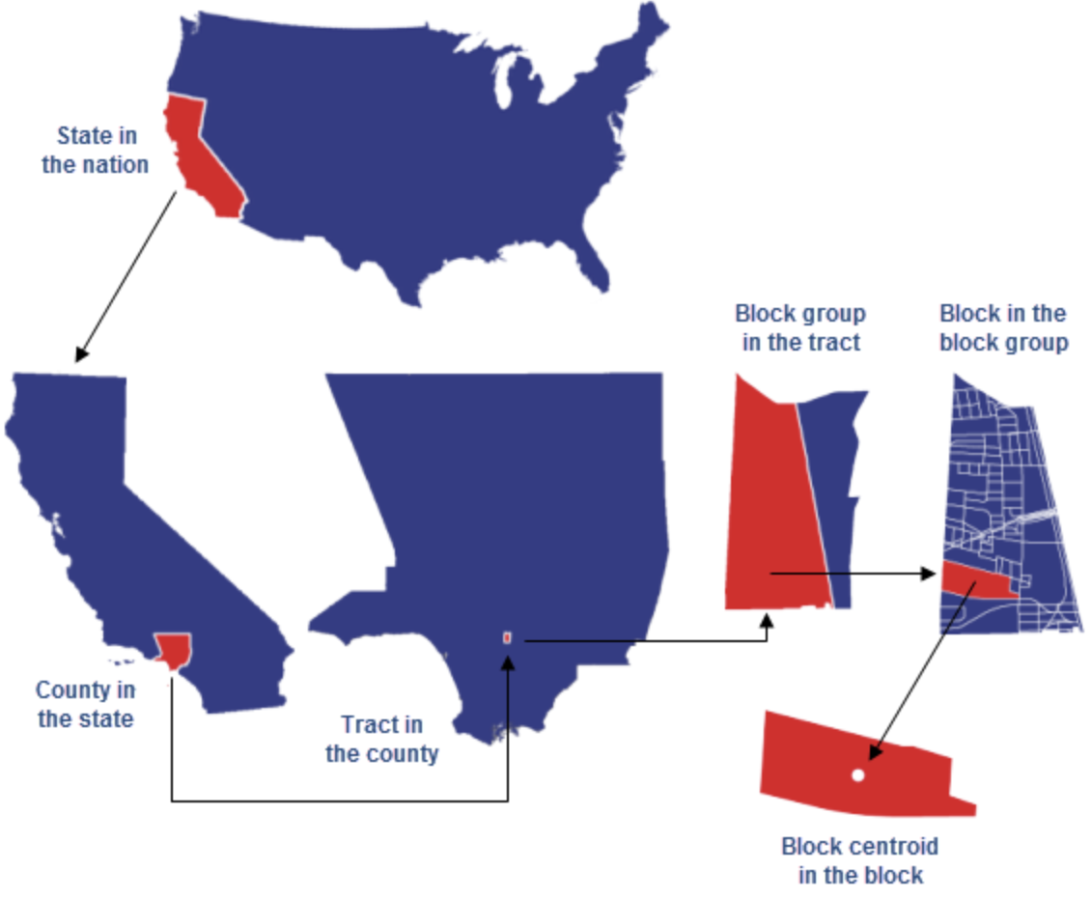
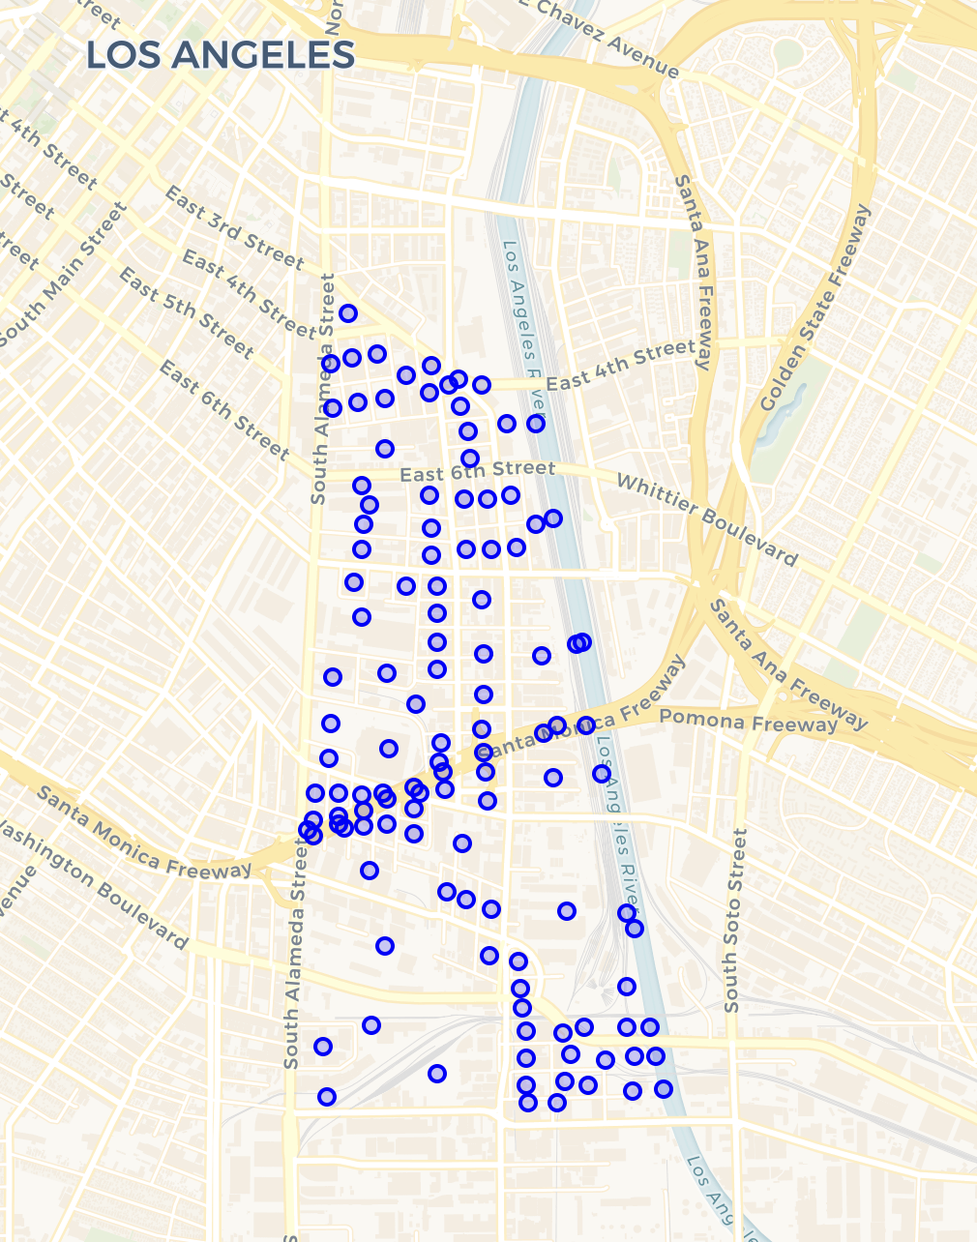
Calculating Accessibility: block origins
Notes:
- We calculate accessibility from fine-grained origins, and we are using census blocks representing residential locations
county 06037
tract 06037206051
block group 060372060511
block 060372060511076

Slide 7
Calculating Accessibility: network inputs
 | purchase observed speeds by segment, time of day
 | GTFS schedule feeds (1000+ nationwide)
 | OpenStreetMap, algorithm to score safety + comfort
 | OpenStreetMap
/
Notes:
then use detailed network inputs to route and model travel times
Different modes require different network inputs

Slide 8






Access to what kinds of Destinations?
Jobs
Education
Healthcare
Food
Entertainment
Intermodal Freight
Enumerated job sectors
Childcare centers
Public and Private K-12
Post-secondary schools
Primary care clinics
Urgent Care
Trauma Centers
Grocery Stores (SNAP retailers)
Convention Centers
Major Sports Venue
Fairgrounds
Airports with Cargo Facility
Pipeline terminals
Rail terminals
Ports
Notes:
- In our database inventory, we source all destinations from publicly available, nation-wide dataset
- Including jobs, education, healthcare, food, entertainment and intermodal freight
- Highlight a few for the rural Minnesota context, specifically on food and education

Slide 9

Access in a Rural Context
Rural area stereotype:
Car dependency
Long travel times
Low density
Few options
How true? how universal?
We use USDA definitions of rural
Notes:
- Back to to the rural Minnesota theme today
When we think about traveling to destinations in rural areas, certain stereotypes : car dependency, longer travel times, low population density, and fewer transportation options. These are common assumptions, but how true are they? And how universal across destination sets and rural context?
The accessibility matrices and method are typically used to access transport system in urban areas, if we are using the same method to apply in rural context, then how are they compared to typical urban settings
We also want to challenge you all to think outside of the box a little, besides driving, what other potions people have to reach destinations

Slide 10
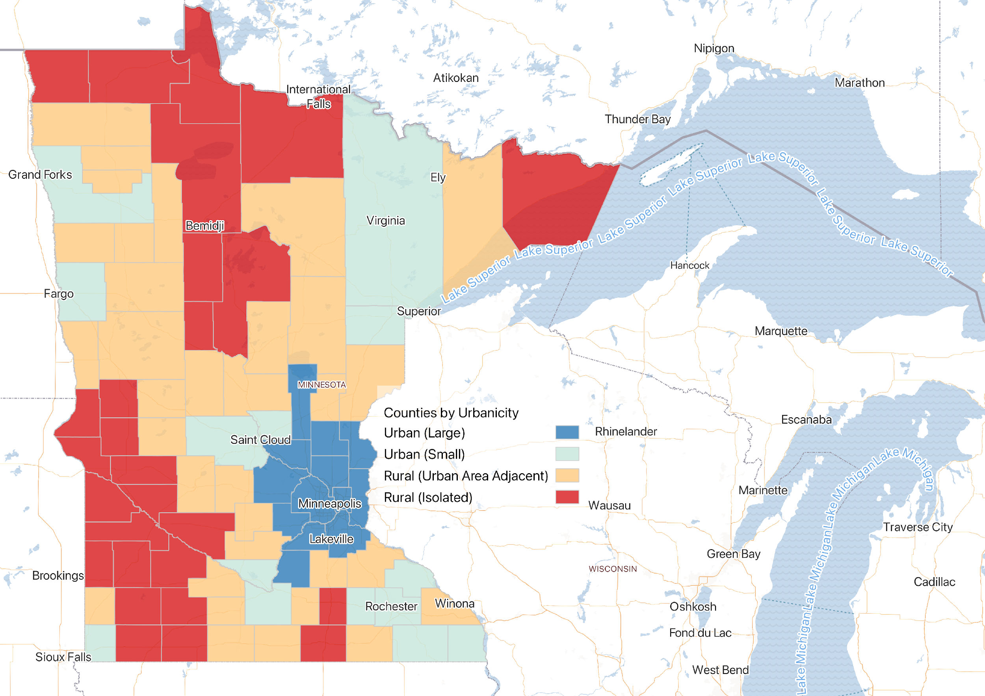
Minnesota Urbanicity and Population
1.2 M
Notes:
Some local context here
We use USDA definitions of urban- rural based on population categorized counties into large and small urban, rural adjacent to urban, and isolated rural area
total MN population in 2020 was 5.7M.
More than half of the population – talking 62% living in the twin-cities metro areas
For rural, that’s about 15 % for counties adjacent to urban, 7 % for isolated counties,
So we’re talking about 1.2M people

Slide 11

Access to education
Public High Schools

Slide 12
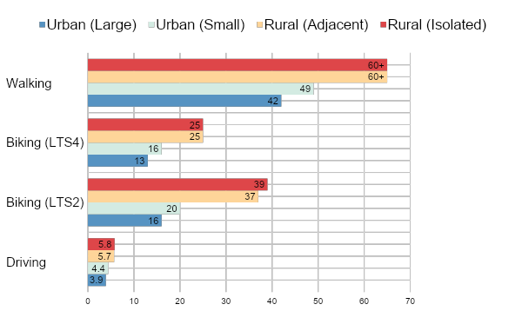

Nearest Public High School and Urbanicity
Driving: From most residential blocks on average, one could get to the nearest HS within a 6-minute drive
Biking (LTS 2): 2x time to bike from a Rural residential block vs an Urban residential block
Biking (LTS 4): If most streets were made safe for biking travel time could be reduced by ~35% (12-13 minutes)
Notes:
Looking at travel time to the nearest public high schools across modes and urbanicity
Driving: From most residential blocks on average, one could get to the nearest HS within a 6-minute drive, not much differences between urban and rural setting
For biking, I have two different types of bike access here representing biking on different stress network, which I will explain next, but looking at the comparison
Biking: on average, it is about 2x time longer to get to a school in Rural compare to Urban
Walking: the average travel time it takes are beyond 60 min in rural setting, while more than 40 min in urban setting, so we learn that walking to high school seems impossible for most people

Slide 13
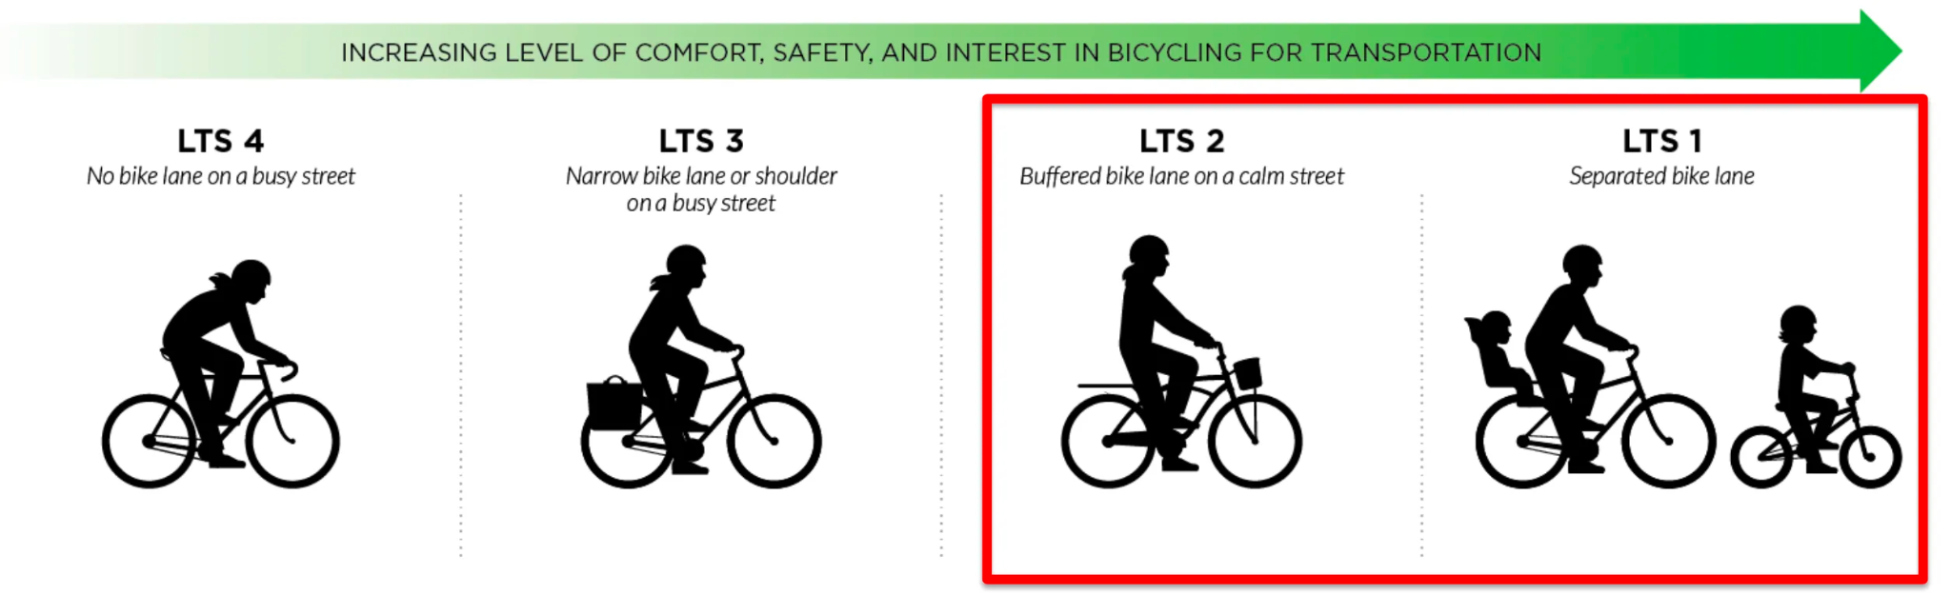
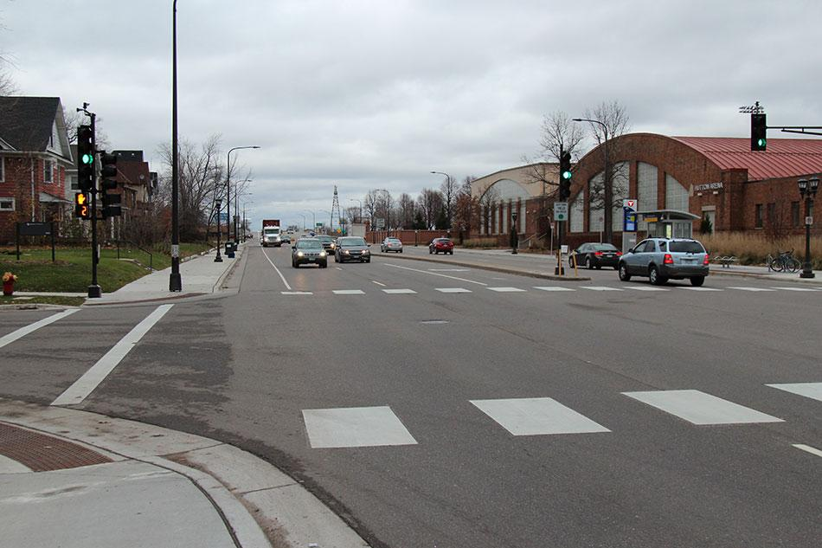
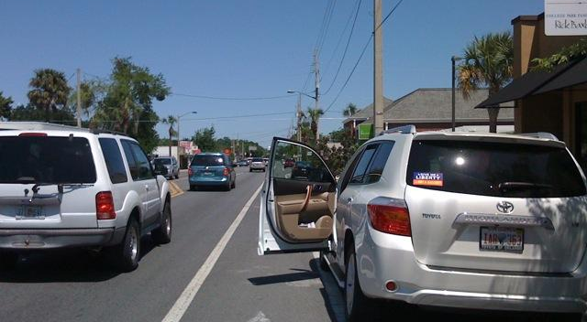
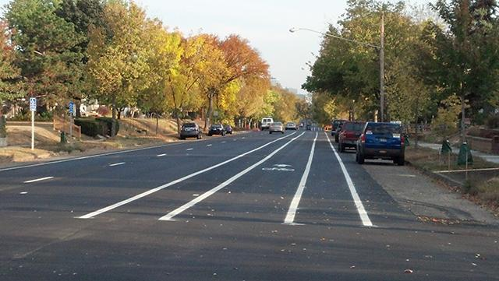
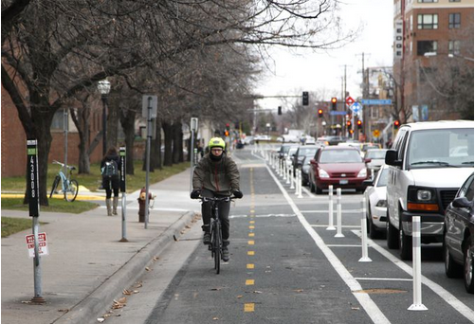
Level of traffic stress (LTS) Analysis
Graphics: Alta Planning and Design
Notes:
Here to introduce the concept of level of Traffic stress - A rating system that measures how much stress a road segment or crossing causes to bicyclists.
LTS 1 and LTS 2 indicates low traffic stress, suitable for people of all abilities.
LTS 3 and 4 representing moderate and high traffic stress usually on a busy street without protected bike lane.
We take into account this road network barrier when calculating bike access.
In an ideal world for cyclist, especially taking about students or family wit children, the more low-stress bike route, the better

Slide 14
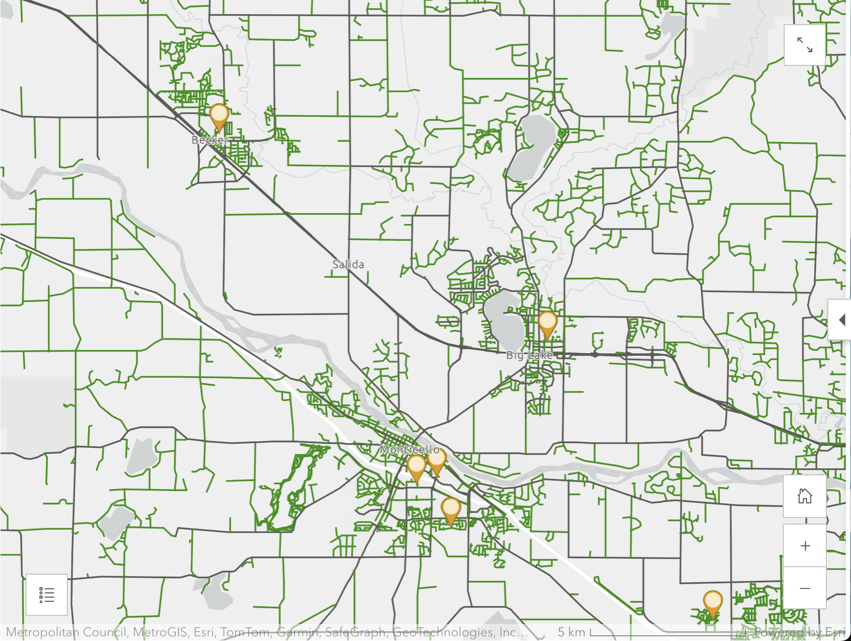
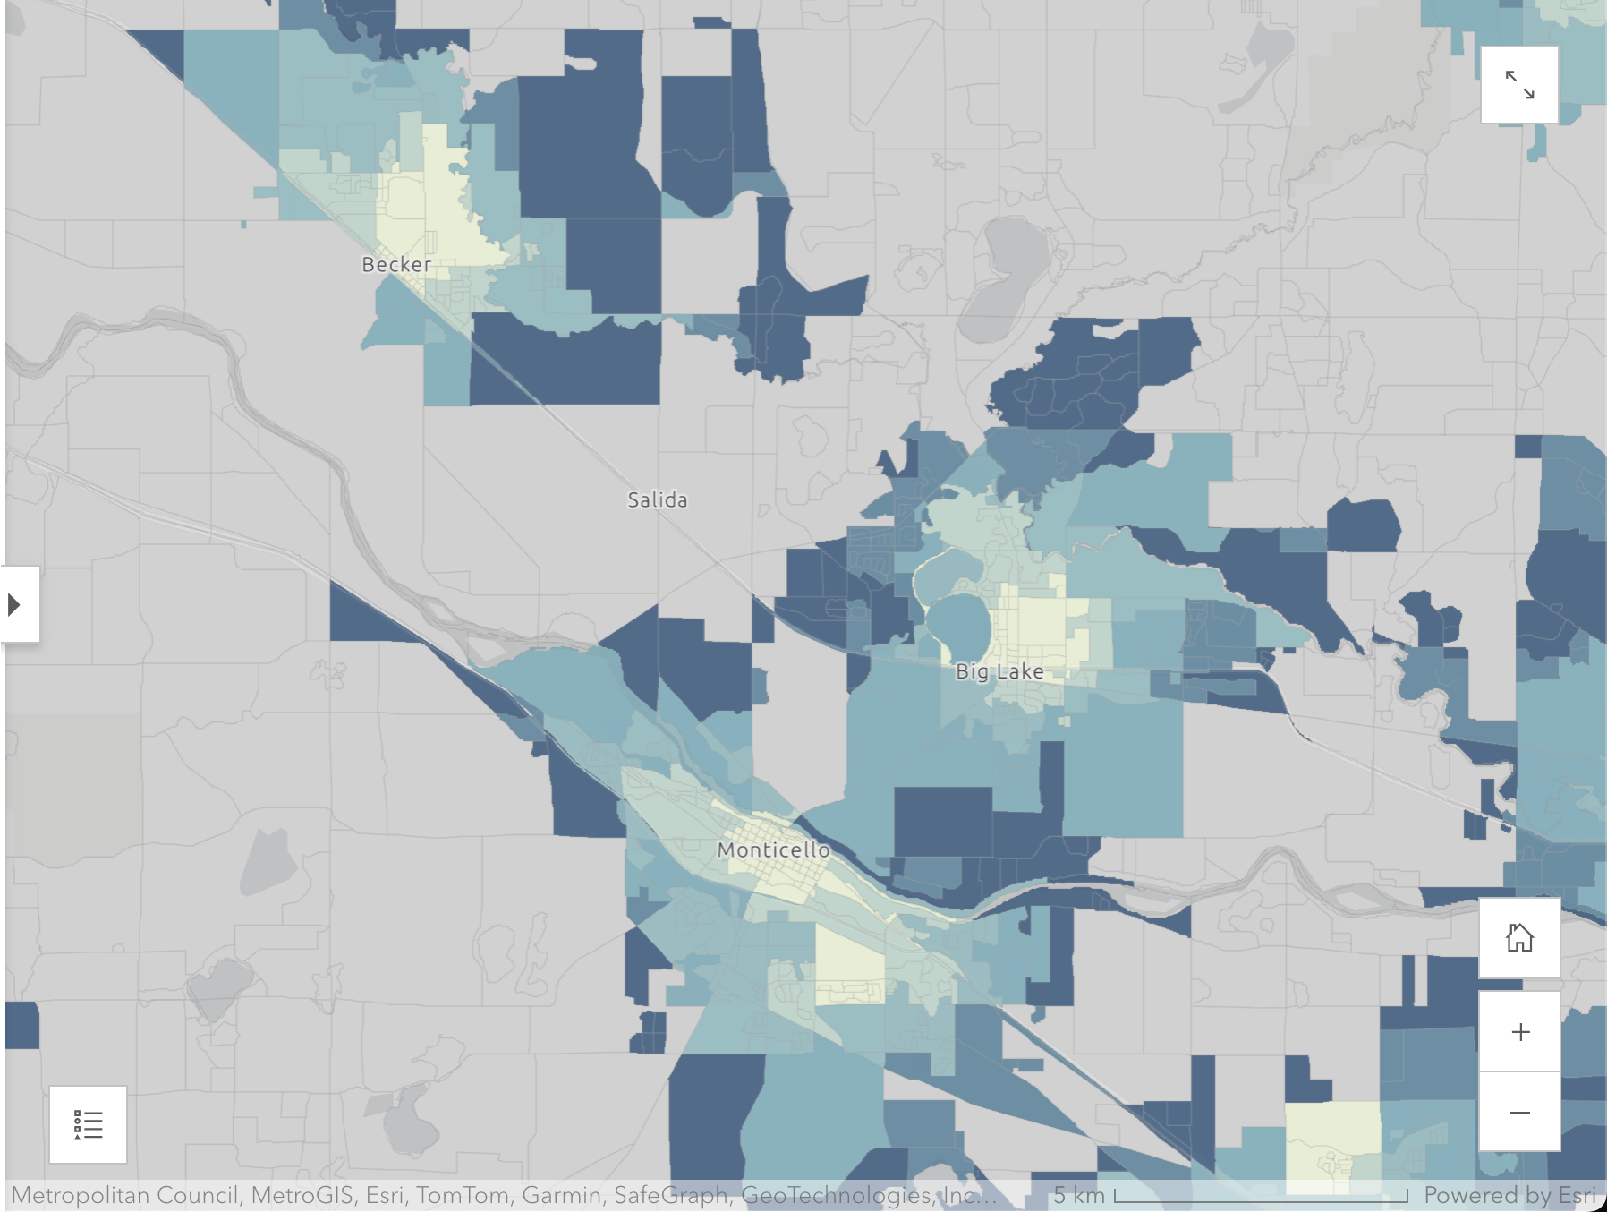
Measuring rural low-stress bike access to HS
Big Lake, MN area
Notes:
- From routing network to access by biking, this option is more meaningful if you don’t have a car or you are 14~
the network map on the left here highlights low stress bike route
The map on the right shows the travel time access by blocks, the color blocks are places where people can safely bike to the nearest high school within a 60 min travel

Slide 15
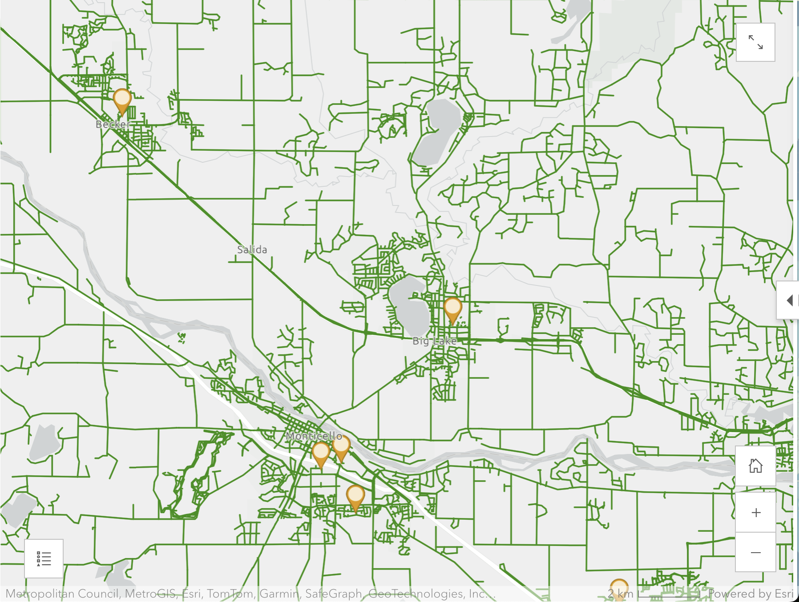
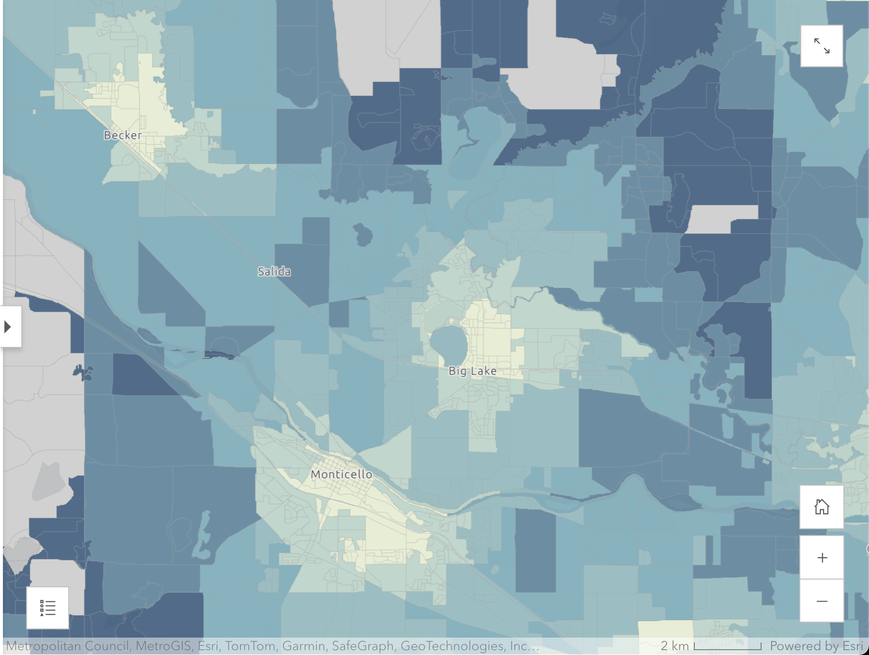
Measuring rural all-streets bike access to HS
Big Lake, MN area
Notes:
Then what about if people are able to route on any open streets
Then we see more places meaning more people can bike to the high school

Slide 16

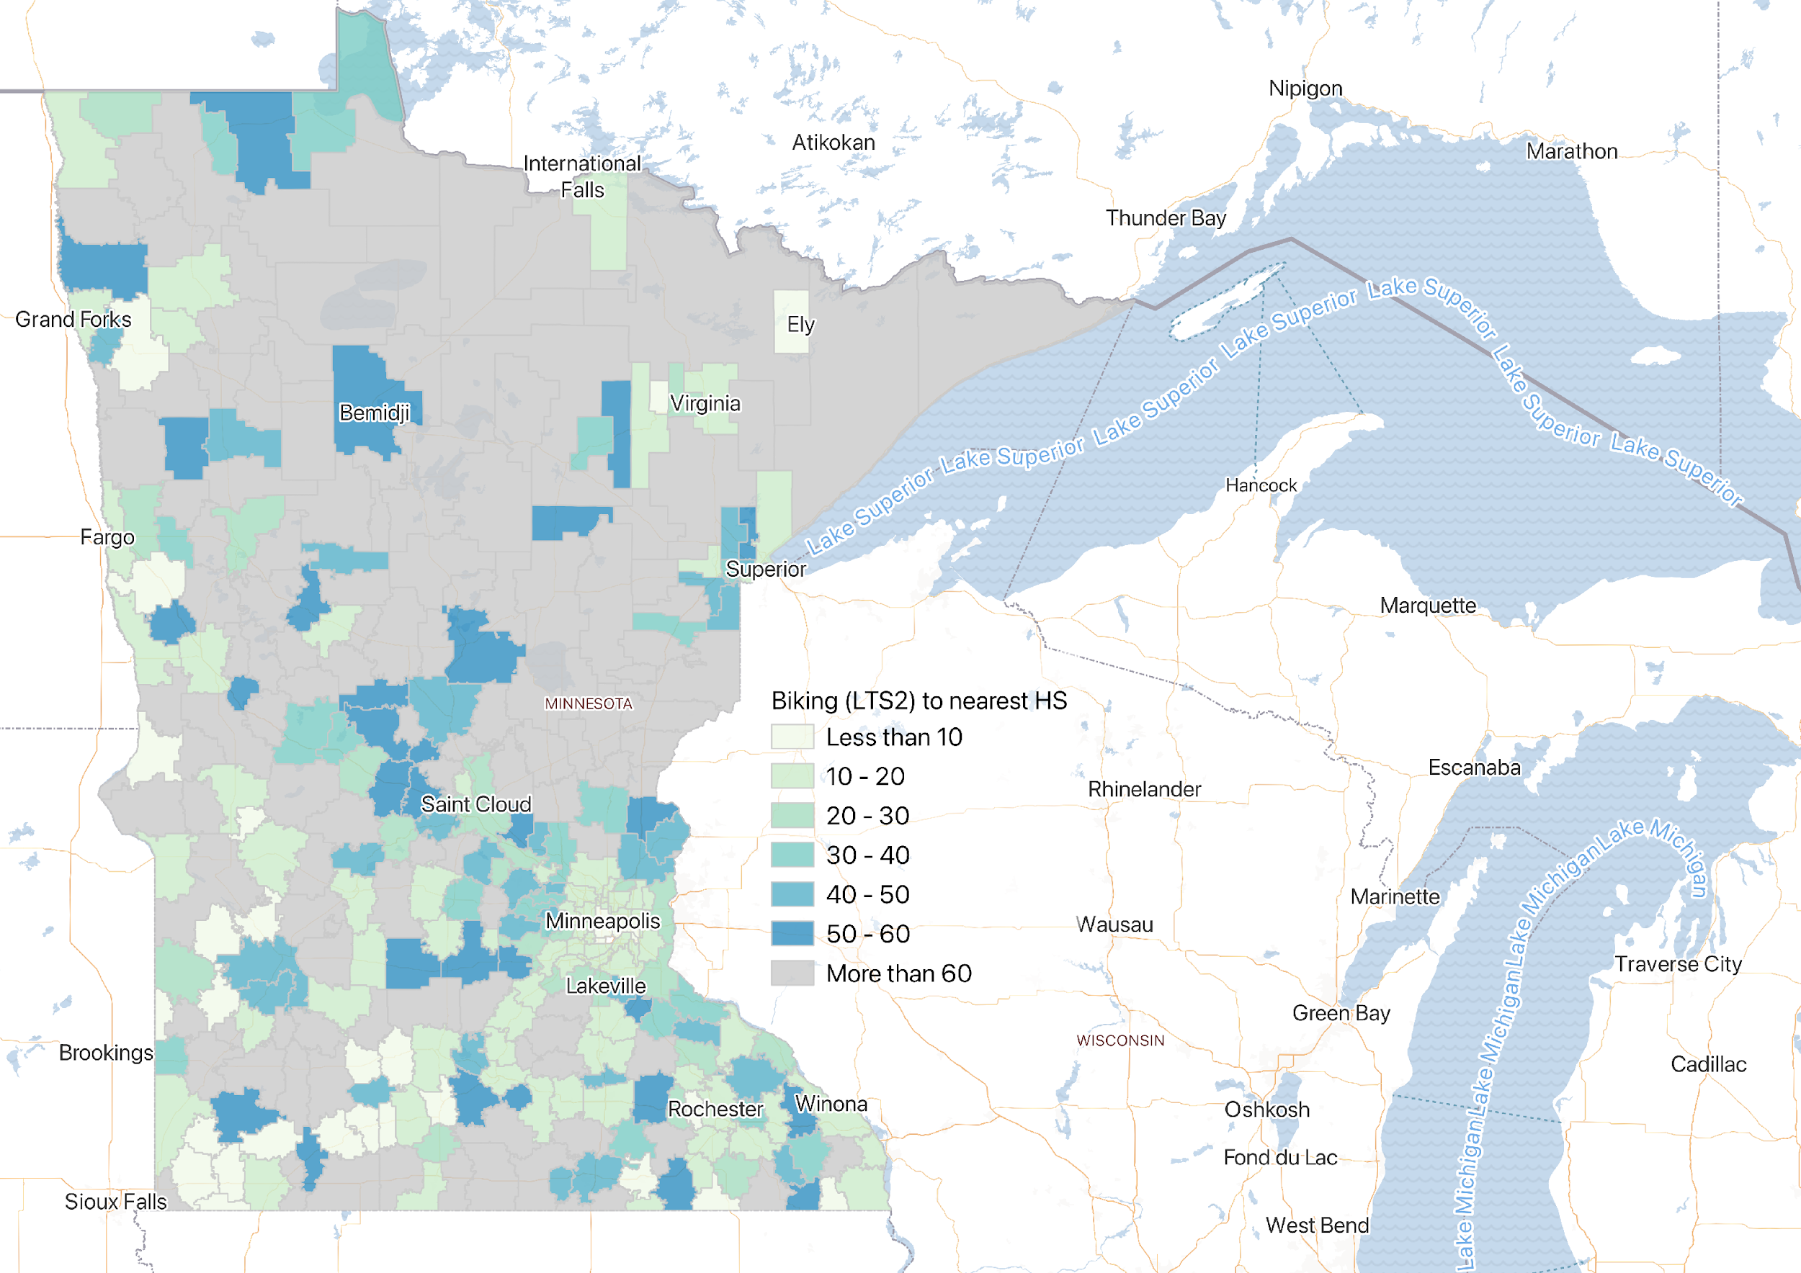
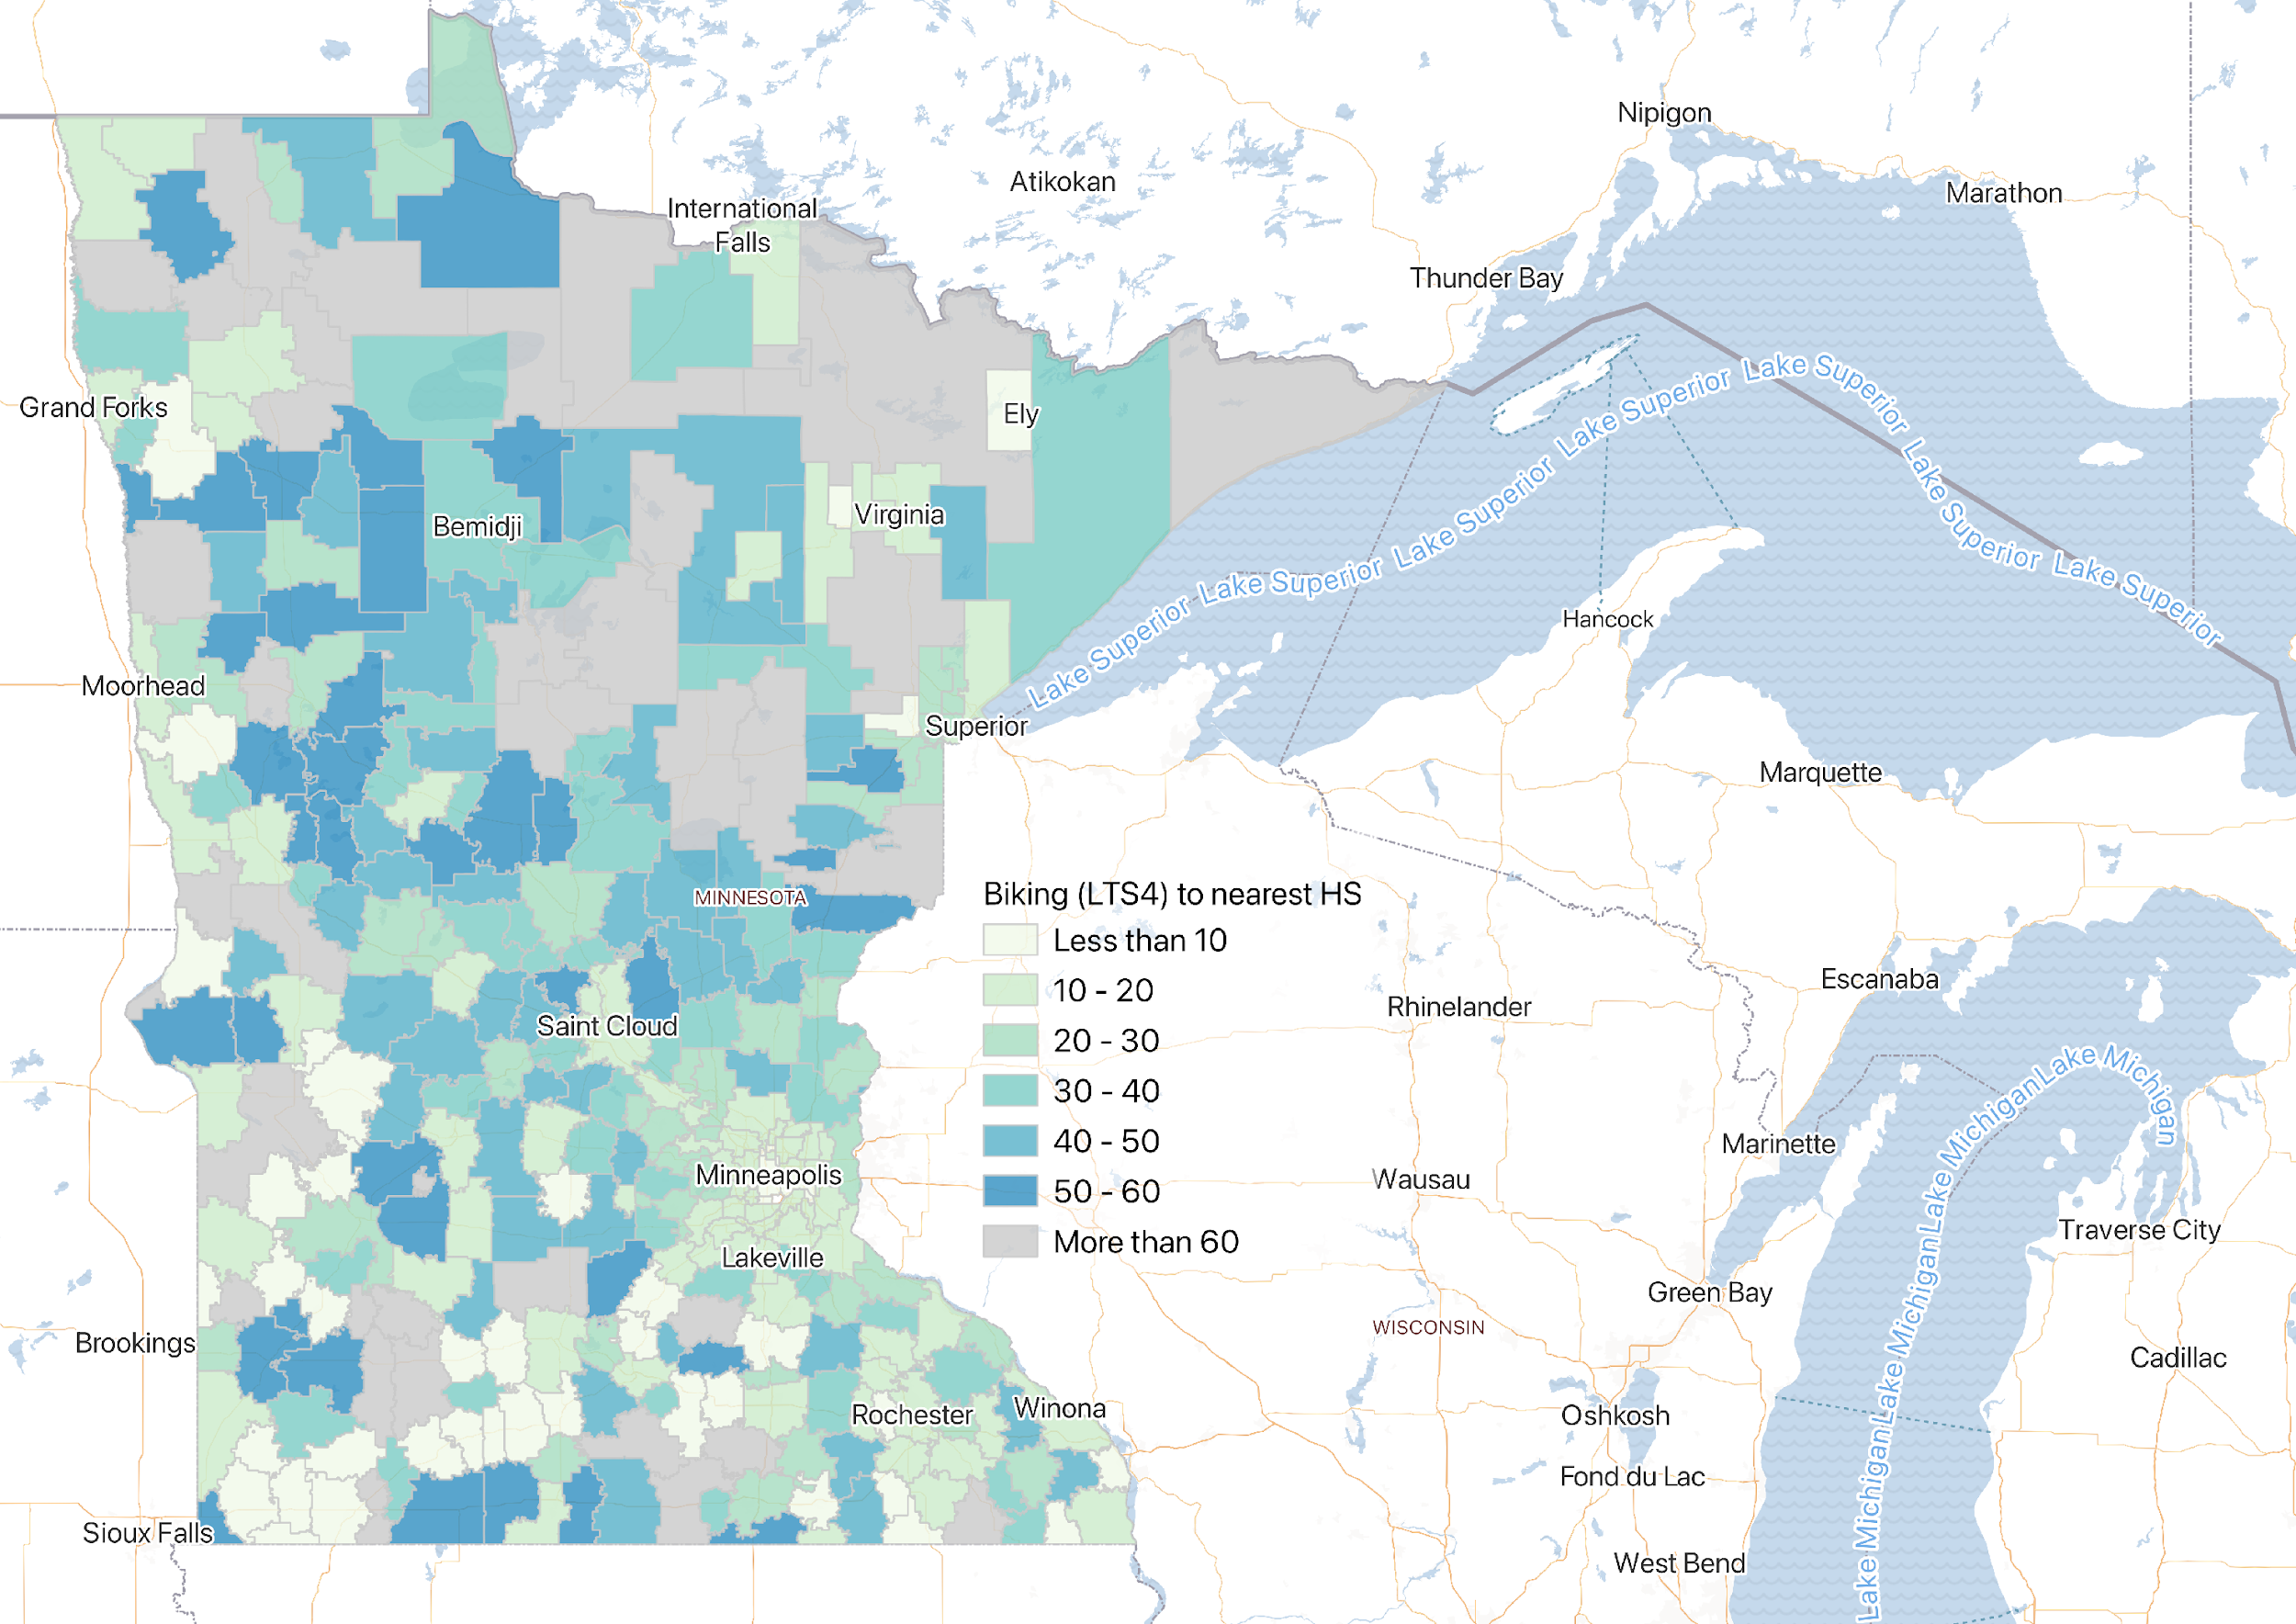
Biking to the Nearest Public High School
Biking on low-stress streets
Biking on all open streets
Notes:
Zoom out to see the county-level profile, looking at the population weighted median travel time to the nearest high school.
biking on all open streets beyond low stress, we are seeing more counties especially rural counties turn blue, meaning now biking could become an option, but depends on how long one is willing to travel

Slide 17
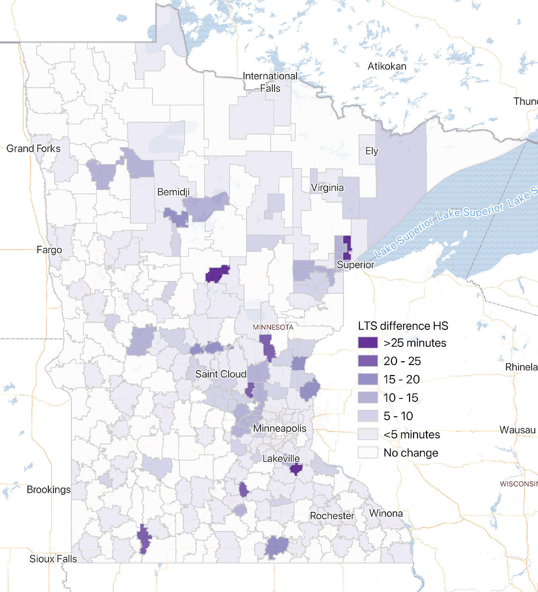
Opportunity to improve infrastructure for safe routes to High Schools
Notes:
We can learn more by taking the difference b/w these maps.
This is the indicator where improved infrastructure would make the biggest difference.
Counties in darker purpose will have the opportunities to improve infrastructure for safe routes to high schools

Slide 18
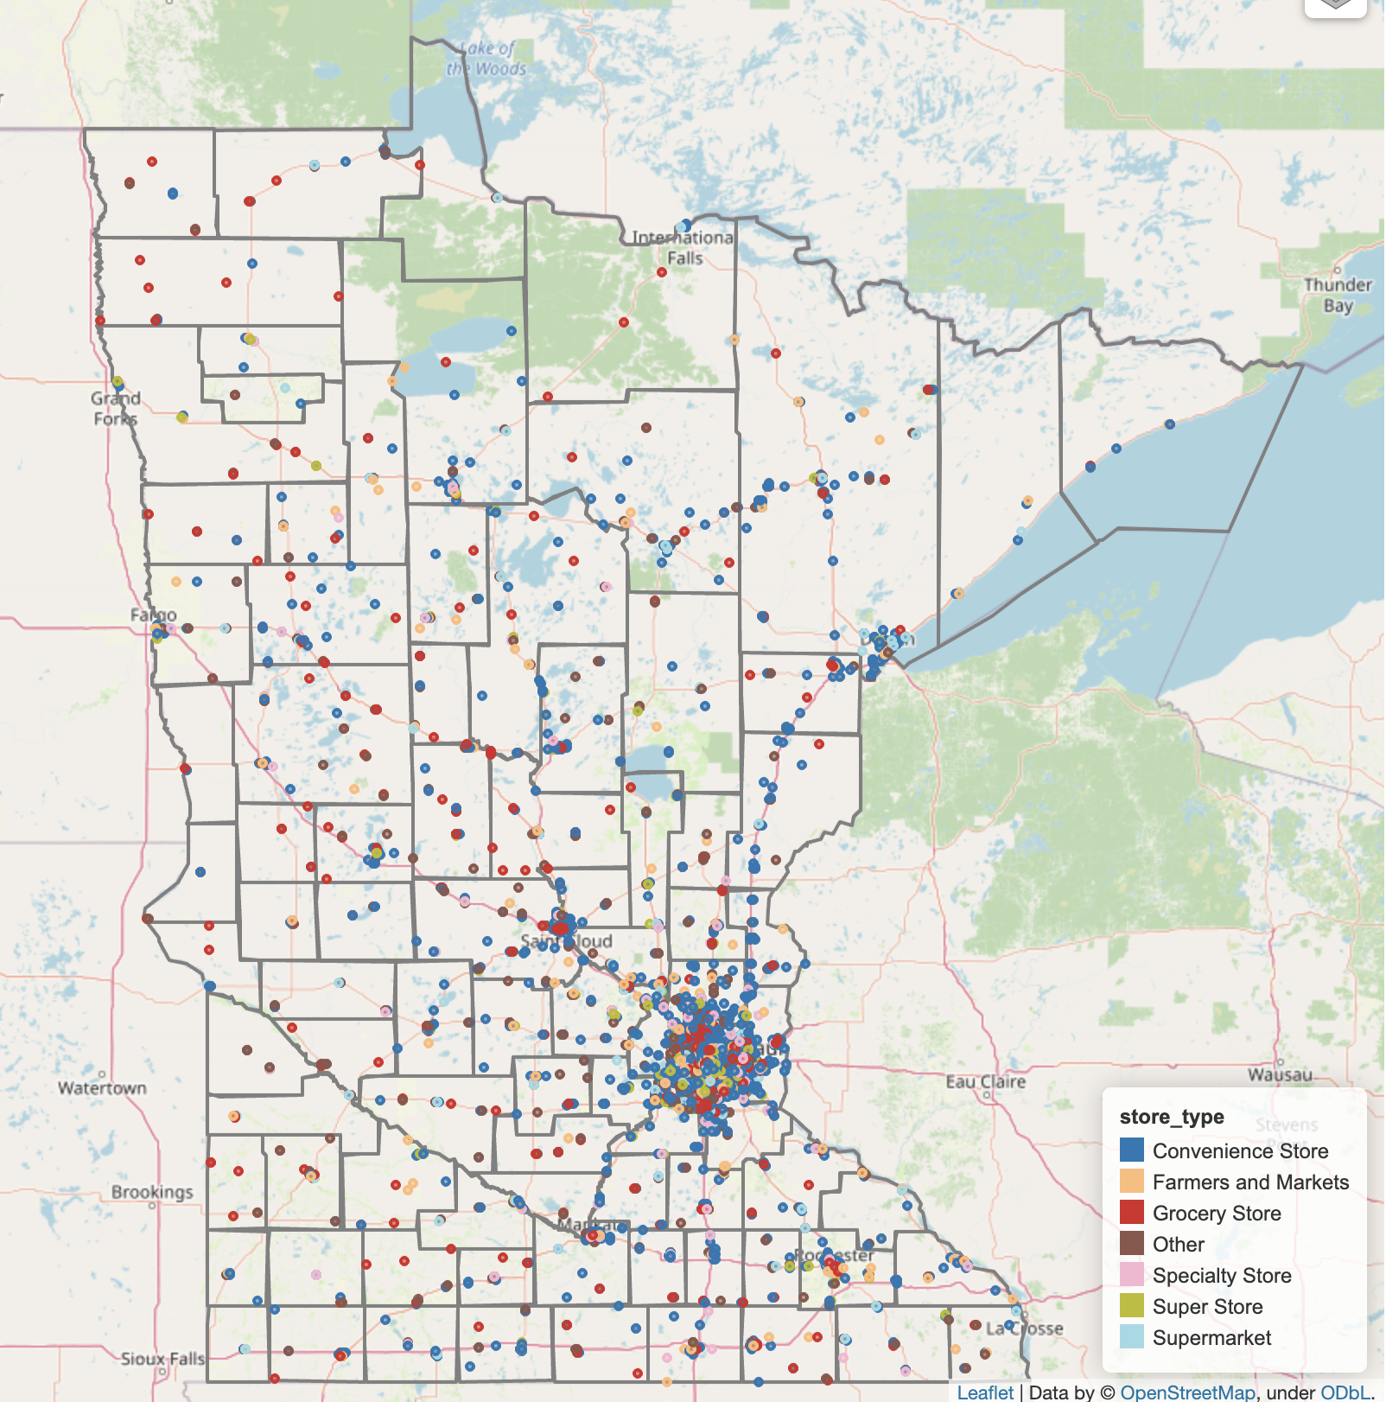
Access to Food
Food Retailers

Slide 19
Urban-rural food environment
Urban-rural divide in Food retailer distribution
How accessible are food retailers by walking and biking?
How do rural communities perform in terms of connecting people to food?
Notes:
The bar chart on the left shows the number of food retailers, the chart on the right show retailer-to-population ratio
Fewer number of retailers in rural & isolated counties
Higher retailer-to-population ratio in rural areas

Slide 20
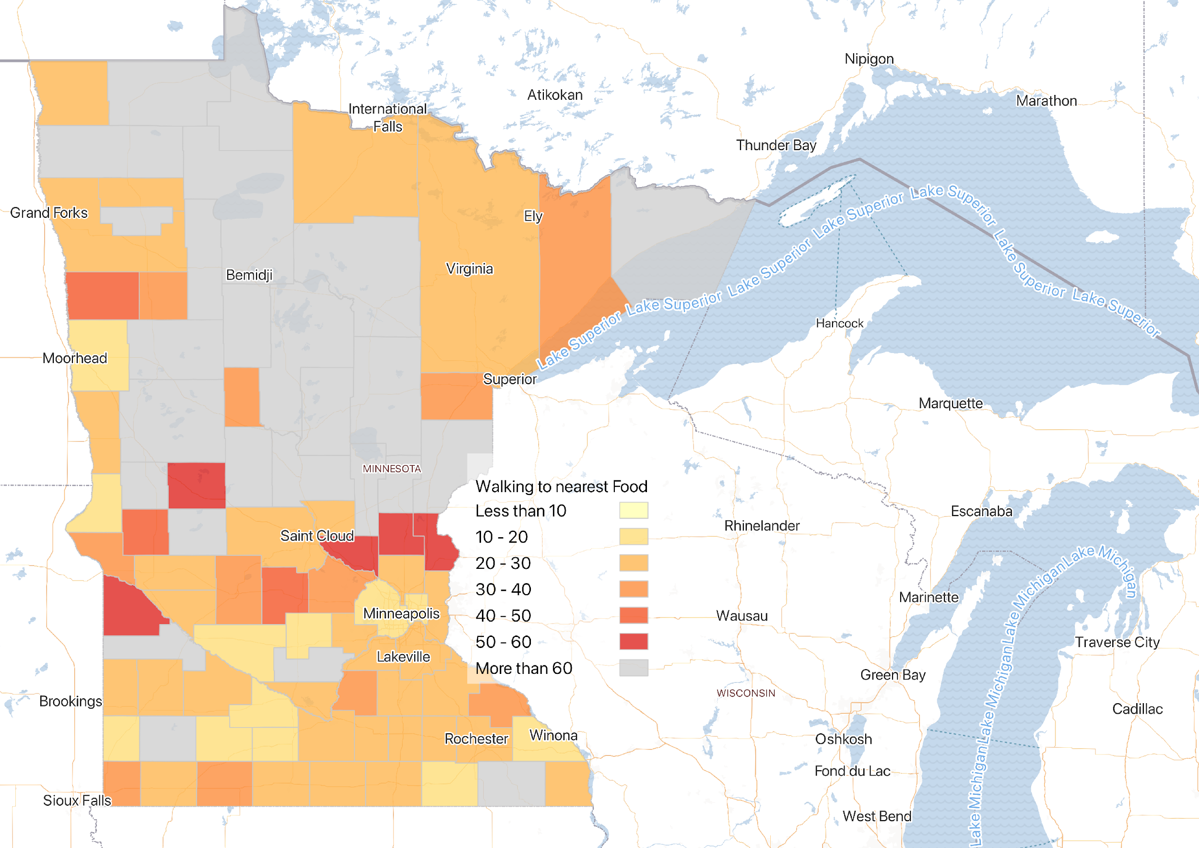

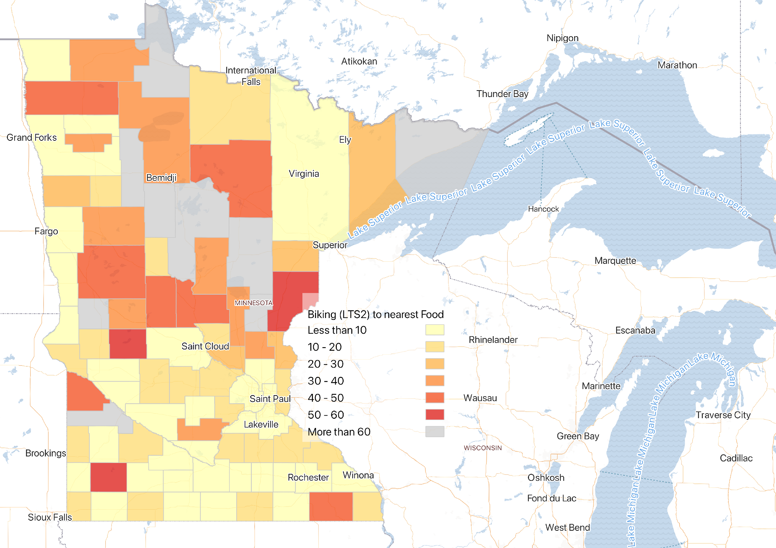
Access to Food
Notes:
Comparing walking and cycling to the nearest food retailer,
Our analysis shows a clear geographic divide in Minnesota.
The southern part of the state demonstrates significantly better walk and bike access to food retailers compared to the central and northern regions.
This contrast highlights regional disparities, but also raises a question about differences in the rural geography of these areas.

Slide 21
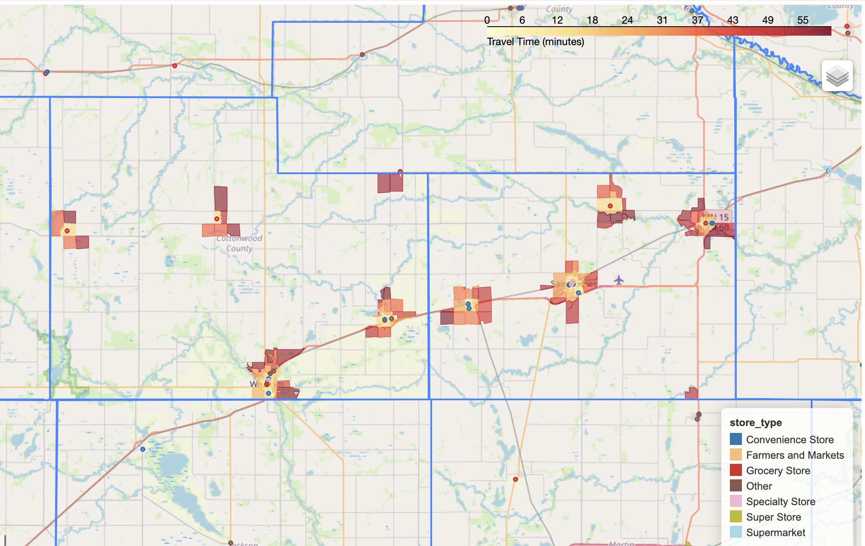
Access to Food
What accounts for differences in rural access?
Let's take a closer look...
Notes:
Cottonwood County (pop: 11517, Rural )
Watonwan County (pop: 11253, adj to metro)

Slide 22
County Name | Urbanicity | Population with Access
Ramsey County | Urban (Large) | 76%
Watonwan County | Rural (Adjacent) | 70%
Cottonwood County | Rural (Isolated) | 65%
Hennepin County | Urban (Large) | 61%
Chisago County | Urban (Large) | 12%
Access to Food
Notes:
The two rural counties are zoomed in here are Watonwan county, and cottonwood county, both show high access to food, about 70% and 65% of population with access, that number is really comparable to the two largest twin cities metro counties like Ramsey and Hennepin
In contrast, we show another urban county, Chisago County (Urban, Large): Only 12% of residents have walking access to a food retailer within 60 minutes.
These findings demonstrate that rurality alone does not determine food access; rural areas can achieve high accessibility, despite low density population, if people live close to destinations, or services
We learn that many localized factors play a critical role in shaping accessibility patterns, including population distribution, historical development patterns, retail locations, and infrastructure planning.

Slide 23

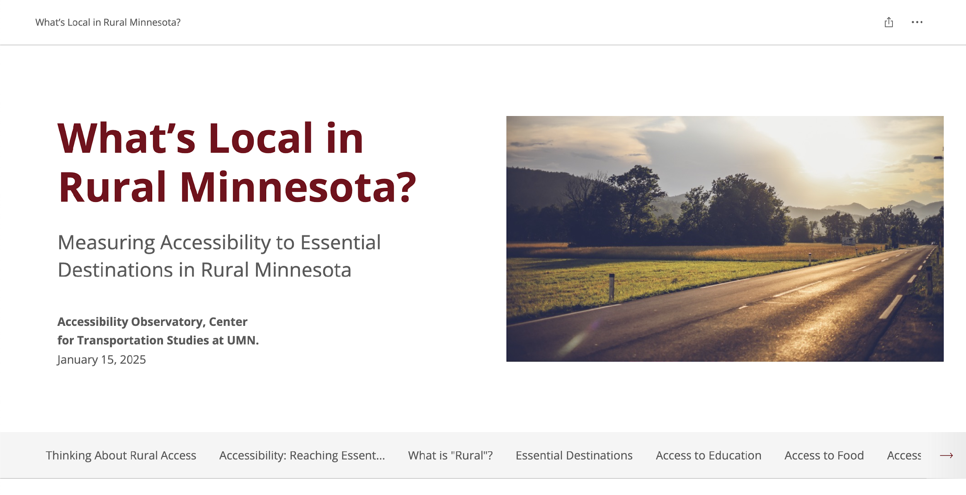
z.umn.edu/rural-access

Slide 24
Thank you!
Shirley Liu
ssliu@umn.edu

